Slide 1
Guiding Principle – Appreciation Harnessing the Power of Authentic Appreciation: Cultivating Optimism, Gratitude, and Celebrations to Inspire Meaningful Leadership
Human Resources
Katie Louise Weir & Doug Owen
February 2024

Slide 2
Opener
Find a partner – not at your table. ☺
Share one activity or event on your schedule this weekend.

Slide 3
Opener Continued…
After you hear from your partner, construct a value statement:
“_______ is important to you.”​
“It’s evident that you care about _______ .”​
“You value _______ .”

Slide 4
Learning Intention
Today we are learning 3 elements of appreciation.
Today we are learning additional strategies leaders employ to foster appreciation.

Slide 5
Success Criteria
We know we will have learned it when we can:
Explain the 3 elements of appreciation.
Brainstorm strategies for fostering a culture of appreciation within our school or department
Plan for implementation of the Appreciation Guiding Principle within upcoming school/department initiatives or key actions

Slide 6
Today’s Big Ideas
Appreciation differs from toxic positivity.
Appreciation is a strong leverage tool.
Appreciation can be applied to a broader range of contexts than initially imagined.

Slide 7
Table Activity
With your tables, select 1 of the following words:
Optimism, Gratitude, Celebrations
Develop a shared definition (use of AI welcome).
Discuss specific ways you implement your selected word within your department/school as a leader.
Identify some possible missed opportunities where you did not implement your selected word.
How does this align to the shared vision/commitment of your department/school?

Slide 8
Table Activity – 5 min
Within your conversations – how does authenticity play into this discussion and your leadership moves/actions within your department/school?

Slide 9
Share Out
Optimism

Slide 10
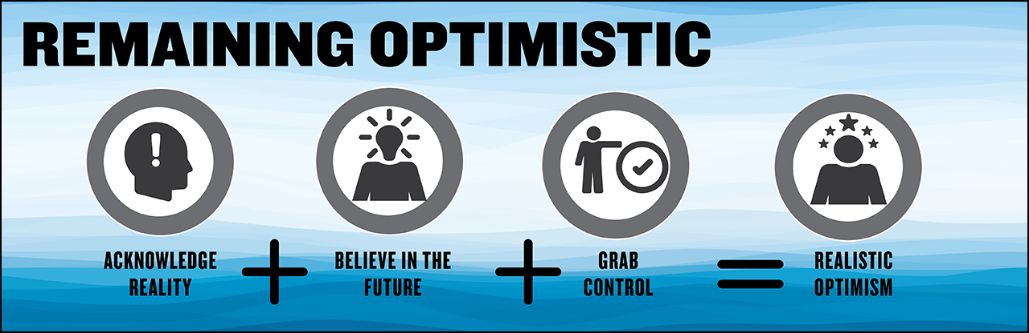
Optimism

Slide 11
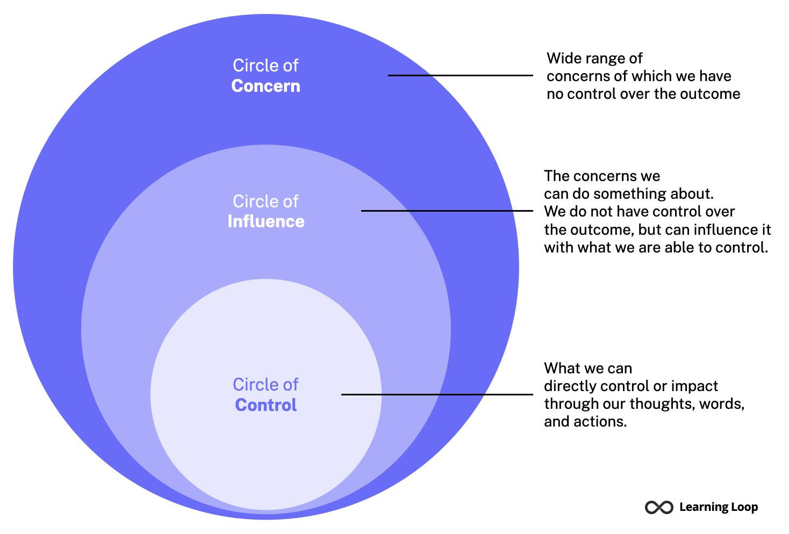
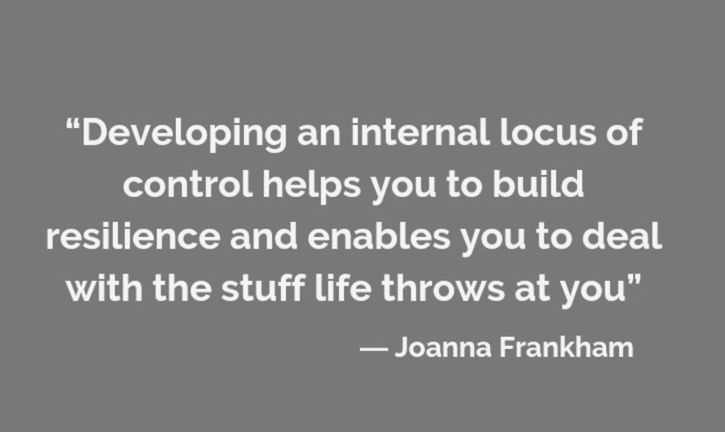
Optimism

Slide 12
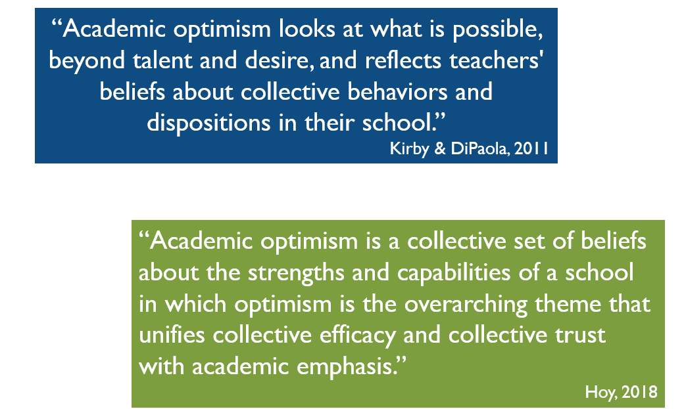

Slide 13
Share Out
Gratitude

Slide 14
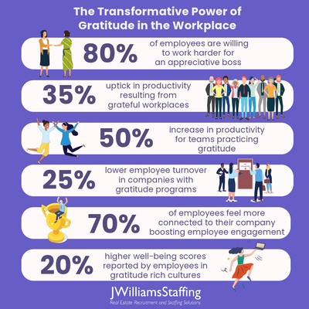
Gratitude

Slide 15
Gratitude

Slide 16
Share Out
Celebrations

Slide 17
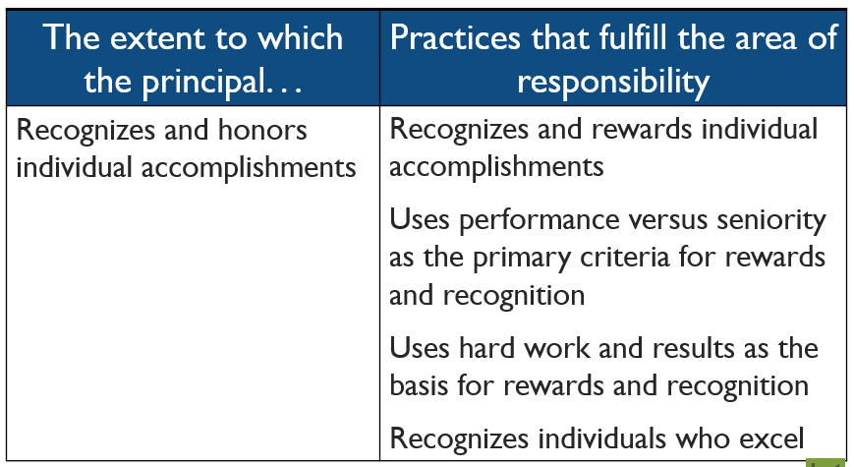
Celebration

Slide 18
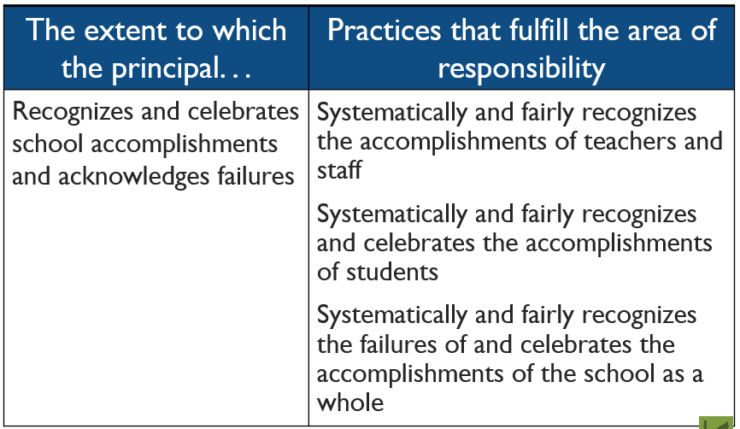
Recognition

Slide 19
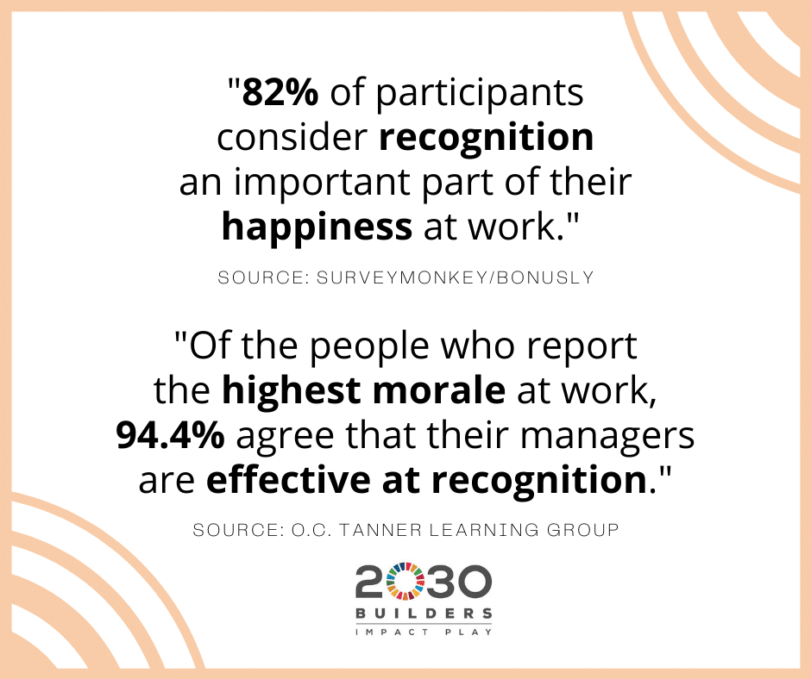
Celebration

Slide 20
Personal Reflection
In what ways does implementation the 3 elements of appreciation we discussed today: optimism, gratitude, and celebration promote a stronger sense of belonging?
How does it support/promote the other guiding principles?
How does this strengthen the culture/climate of WCSD?

Slide 21
Learning Intention
Today we are learning 3 elements of appreciation.
Today we are learning additional strategies leaders employ to foster appreciation.

Slide 22
Call to Action
Consider a specific person/team:
What is 1 way you can commit to employing genuine appreciation within your leadership practices for your school teams/departments within the next week?

Slide 23
Concluding Thought
“The litmus test of all leadership is whether it mobilizes people’s commitment to putting their energy into actions designed to improve things. It is individual commitment, but above all, it is collective mobilization.”
– Michael Fullan, Leading a Culture of Change

